Slide 1
International DX Convention
Visalia, CA – April 2016

Slide 2
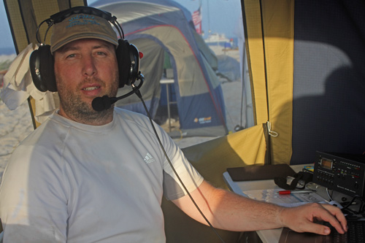
Jared Smith - N7SMI
Insights From a DXpedition Newbie

Slide 3
N7SMI – About Me
Licensed in 2011
270+ entities worked
Caught the DXing bug after logging T32C
I wanted to go on a DXpedition, but who invites a newbie??? … so I planned my own...

Slide 5
TX7G – Marquesas Islands
October 18-26, 2014
Nuku Hiva, Marquesas
#69 Club Log Most Wanted
Four team members
Grant Saviers - KZ1W
Keith Witney - VE7KW
Donald Studney - VE7DS
27,237 QSOs

Slide 6
Notes:
Largest sunspot in 24 years

Slide 8
VK9WA – Willis Island
November 14-23, 2015
#32 Club Log Most Wanted
N7SMI and N7QT – Co-team Leaders
VE7NY, K7EDX, SM5AQD, SM3SGP, VE7SZ, and W8HC
61,738 QSOs
<$1/QSO
Notes:
The vast majority of our budget was the charter vessel

Slide 9
T2M – Tuvalu
September 27 – October 4, 2016
N7SMI and KK7L (John)
Focus on training and supplying equipment to create an active Tuvalu Amateur Radio Club

Slide 10
My thoughts on the future of DXing
DXers can be better mentors and elmers
The primary barrier to entry is HF transceiver costs
Is DXing becoming more competitive than collaborative?
Are we losing the lore of DXing?
DX IS
The QRPer storming up the hill to see “The Old Timer”
Notes:
Marathon, etc.

Slide 11
Is on-air behavior getting worse?
“One of the worst things which can happen to spoil DX for all of us and the DX too, is the continual calling which some stations engage in when the DX is busy with another station. It is doubly worse when the calling station is right on top of the DX. Either the contact is spoiled for the local or the DX station gets a little fed up and leaves the air. A little bit of education for some of the responsible stations causing this kind of trouble is certainly in order. Just how to accomplish this has been studied by both QST and CQ for months but to this date nothing has come up worthy of a trial.”

Slide 12
Is on-air behavior getting worse?
“One of the worst things which can happen to spoil DX for all of us and the DX too, is the continual calling which some stations engage in when the DX is busy with another station. It is doubly worse when the calling station is right on top of the DX. Either the contact is spoiled for the local or the DX station gets a little fed up and leaves the air. A little bit of education for some of the responsible stations causing this kind of trouble is certainly in order. Just how to accomplish this has been studied by both QST and CQ for months but to this date nothing has come up worthy of a trial.”
- W6PB - August, 1948
NCDXC Newsletter archives online – 1948-present
Notes:
Ever-changing nature of the DXCC program.

Slide 13
So you want to organize a DXpedition?
Go for it! But be prepared!
Be ready for coopetition.
It’s not that expensive. Many Top 100 entities are relatively inexpensive.
Build a great team
Invite “team members”, not “operators”
Team players you can get along with
Bring along a “newbie”
Define team goals, expectations, operating guidelines, etc.

Slide 14
So you want to organize a DXpedition?
Managing finances is a lot of work
Be transparent with the team
Get community buy-in
Hams are generous, but show them the value.
Web site, newsletter (>$10 donors), social media.
Be the QSL manager (at least once)
You’ll focus more on accuracy next time
Have fun!!!

Slide 15
Jared Smith - N7SMI

Slide 16
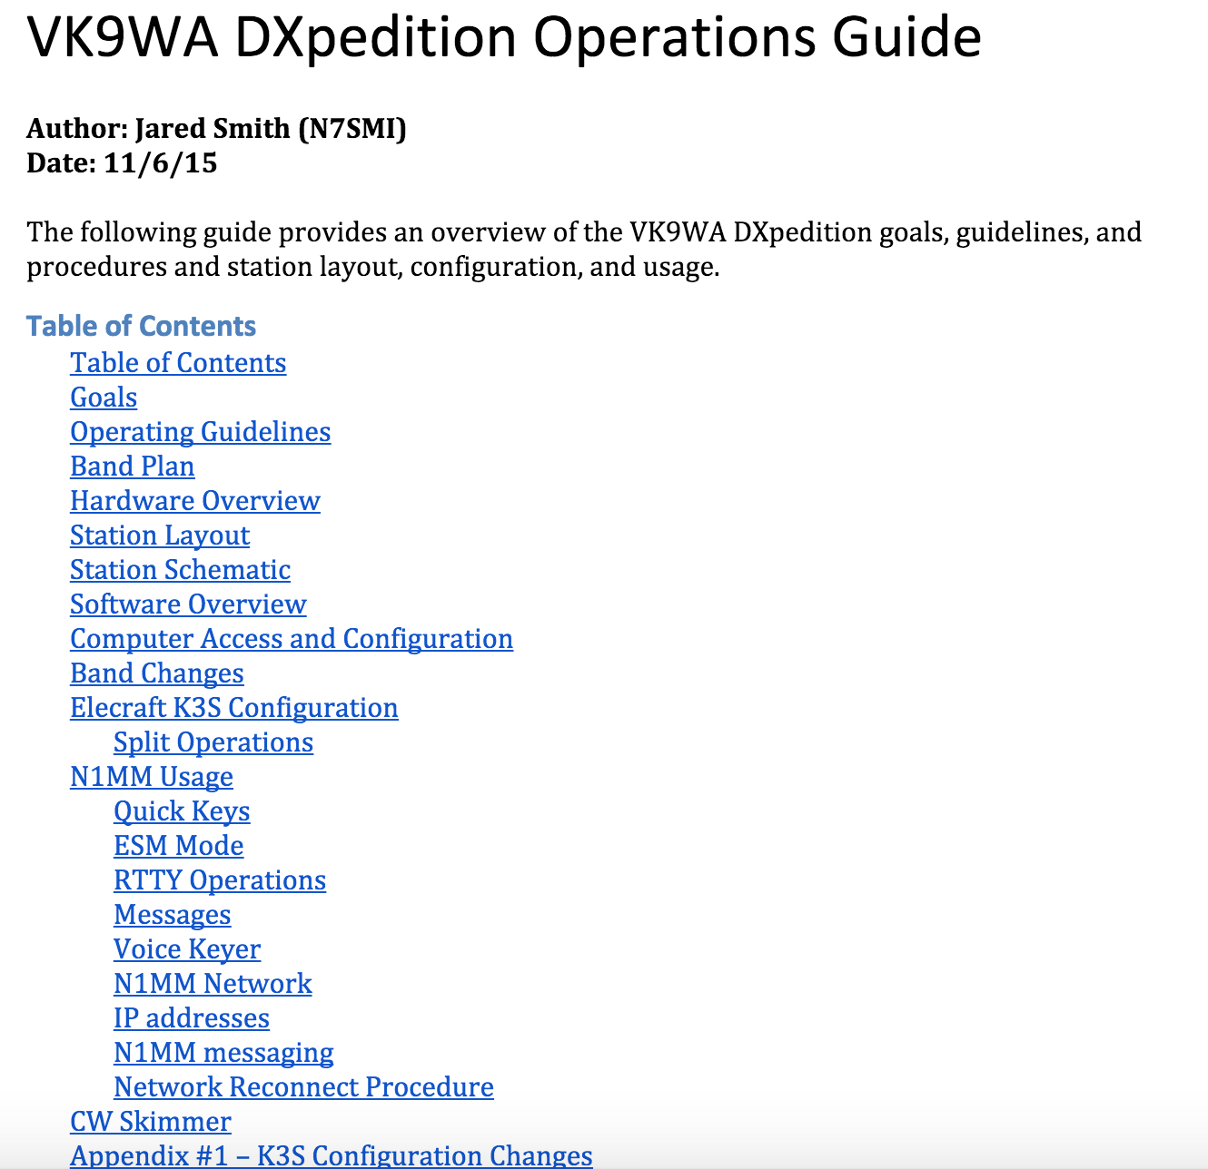
So you want to organize a DXpedition?
Notes:
20 pages
Maritime mobile
Stage EVERYTHING

Slide 17
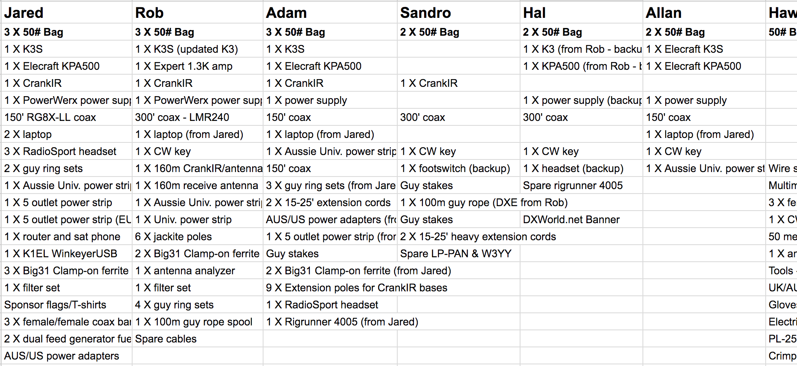
So you want to organize a DXpedition?
Notes:
20 pages
2 team members twice the work, 3 team members 3X the work…

Slide 18
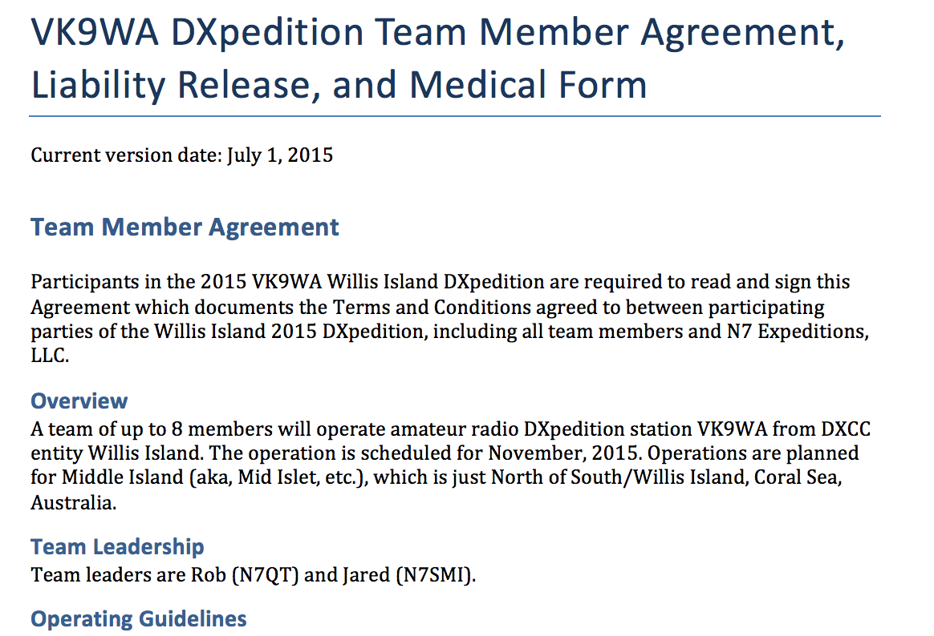
So you want to organize a DXpedition?

Slide 19
DXpedition Operating Tips
"N7SMI 59" rather than "Roger, N7SMI, you're 59. QSL?”
Be conversational. Martti Laine-style.
Use variable CW speed
4-6wpm faster for <<5NN>> & <<TU>>
.25 seconds/QSO X 31000 QSOs = 2.2 hours saved (several hundred more QSOs)
Learn the power of the Check window
Notes:
N1MM donor names.

Slide 20
Your Questions
Information on using the Crank IR on 160
Will most DXpeditions work to fix broken calls after the operating period is over?
What's the best practice you can get (stateside) to prepare for running a pileup when you're the DX?
If I want to go on a DXpedition, do I need to learn to touch type?
Notes:
Make pileups.
Listen to pileups
YouTube videos

Slide 21
Your Questions
Help with massive pileups.
Listen, especially for hints.
Unless you’re really loud, be where the DX will be, not where he is.
Learn his pattern.
When the DX station gives his full call, he’s (probably) turning the dial.
Transmit good audio (!= more compression)
Use standard phonetics (most of the time).
Notes:
You don't want the pileup guessing. You want those that listen to be rewarded.

Slide 22
Your Questions
Help with massive pileups, cont’d.
Tail-ending?
If you call out of turn, you will be ignored
If you don’t have and use a sub-receiver to monitor the pileup, you’re at a disadvantage
Notes:
YouTube - VK4...

Slide 23
Your Questions
What can DXpeditions do to address DQRM?
Be loud and keep the rate up.
Make everyone think they’ll be the next one in the log.
Slow down to speed up:
Recent DXpedition at 40wpm
~60% of QSOs required repeats.
Effective speed = ~15wpm
Be ABSOLUTELY consistent.
Never work out of turn callers
Notes:
Wayne will cover in more depth
Most QRM is not deliberate.
EU only, then taking JT1…

Slide 24
Your Questions
What can DXpeditions do to address DQRM?
Recognize cultural and regional differences
Work by regions, but don’t neglect folks
Work and log dupes
Sign very frequently. At least every 3rd QSO.
Use the bandwidth necessary – but no more.
By the numbers vs wider split?
Notes:
Wayne will cover in more depth

Slide 25
Questions???

